Slide 1

Chimeric T-cell (CAR-T) Immunotherapy on
B-cell Acute Lymphoblastic Leukemia (B-ALL)
Zhaoyang Jia

Slide 2
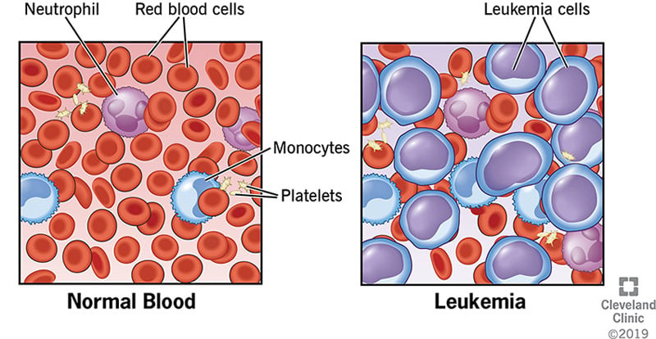
B-cell Acute Lymphoblastic Leukemia (B-ALL)
Leukemia cells crowd out health bone marrow
Over-proliferation of B-cells, reduction in normal blood cells
20% - 25% of all cancers for children below 19
About 2k-3k cases each year
The survival rate has increased to over 90% post mid-2000s
Treatment
Chemotherapy (1 month – 3 years)
10% - 15% refractory/relapsed
Donor stem cell transplant
T-cell Engager Immunotherapy
39% remission rate
CAR-T therapy
81% remission rate (Hucks 2019)
Hucks and Rheingold, 2019
Hunger et al., 2013
Notes:
Leukemia cells are cancerous blood-making cells, in the bone marrow
Leukemia overproliferated immature lymphocytes (lymphoblast)
Reduction in normal blood cells: compromised immune-system, lower oxygen supply, etc.
About 200 life in the US alone
Refractory or Relapsed
Blinatumomab

Slide 3
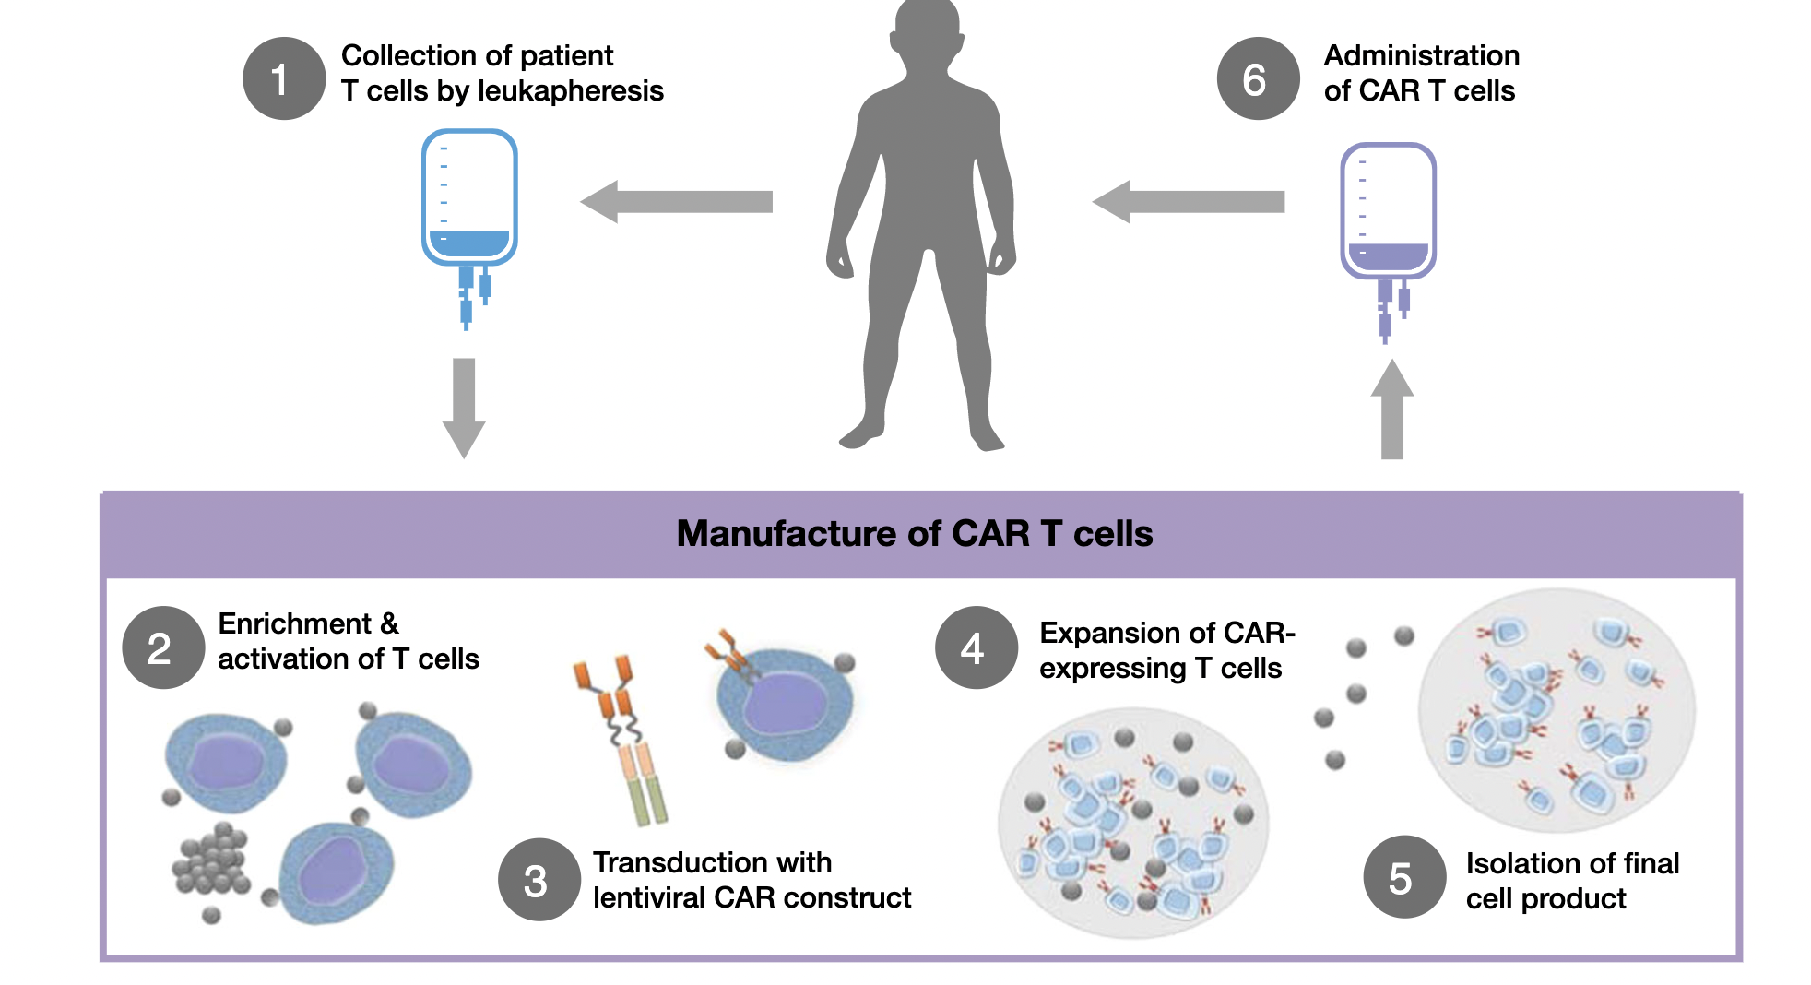
B-ALL CAR-T therapy
tisagenlecleucel (formerly CTL019)
Contains an extracellular domain that recognizes CD19-antigen
CD19 is a B-cell marker
CD19 is not present on hematopoietic stem cells
Hucks and Rheingold, 2019
Wang et al., 2012
Notes:
OE of CD19 is associated with OE of c-MYC, forming a positive feedback loop: OE downstream effectors, causing over-proliferation
Immunodepletion creates prior to CAR-T injection creates space for CAR-T in the lymphoid organs

Slide 4
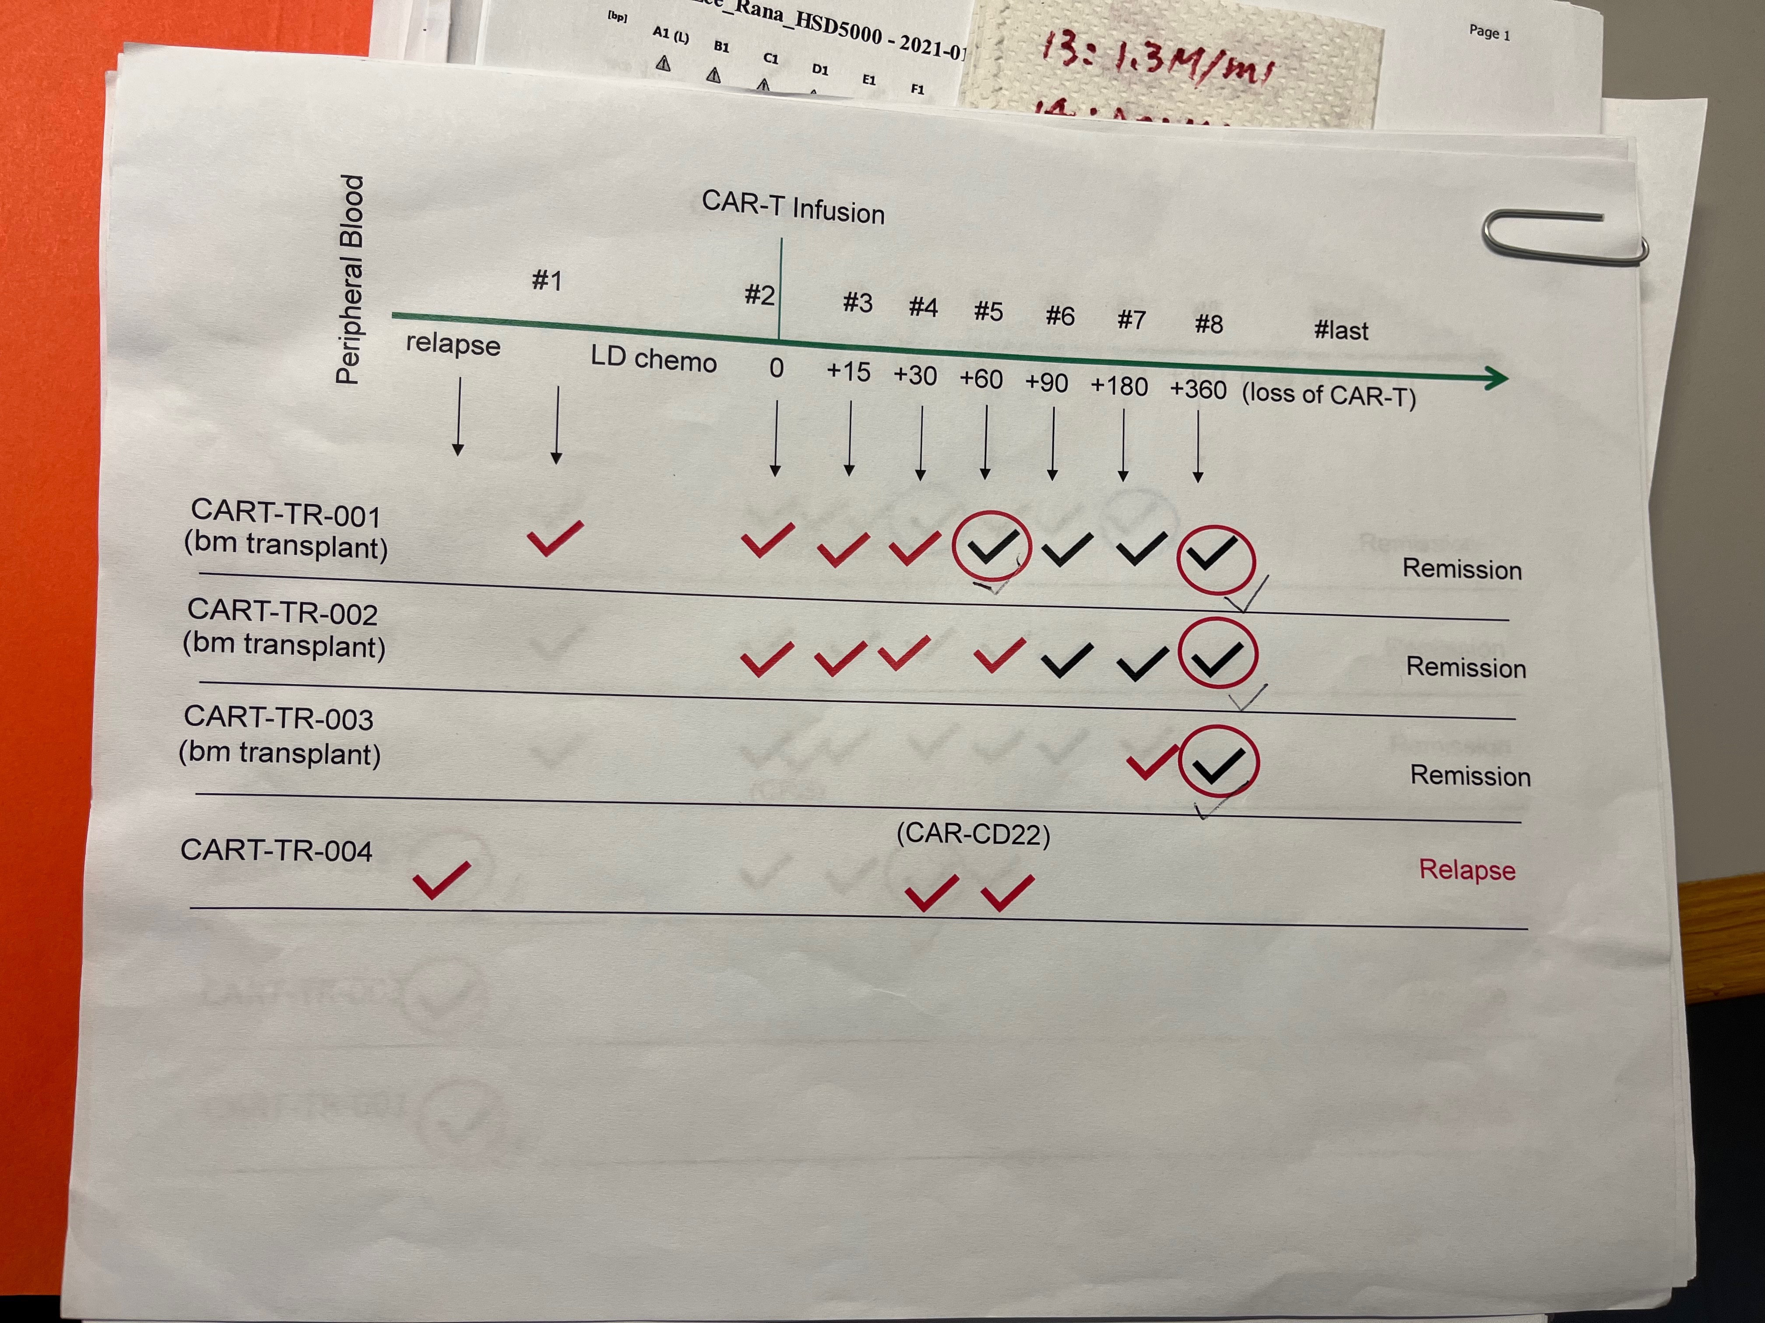
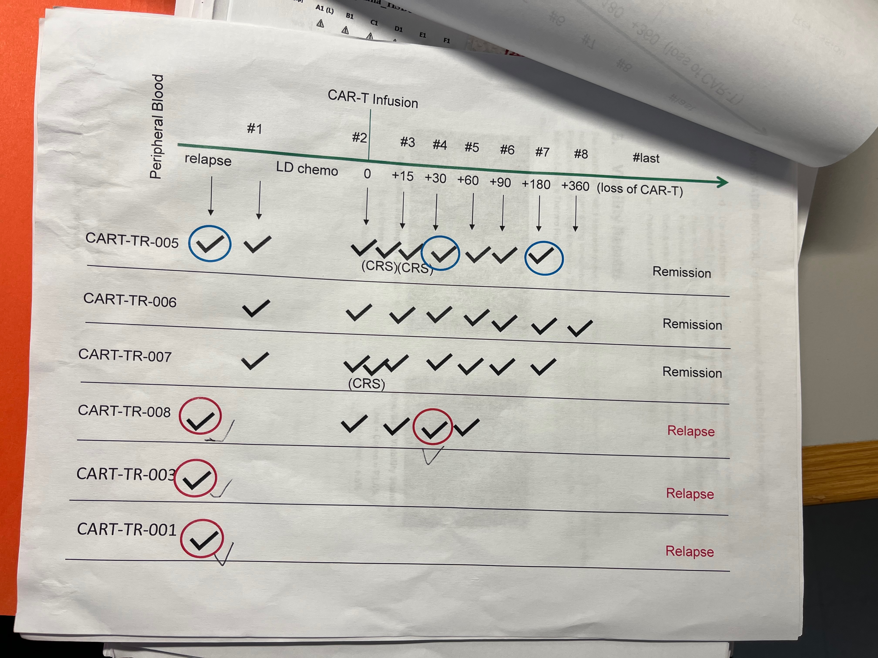
Relapsed
Relapsed
Relapsed
Relapsed

Slide 5
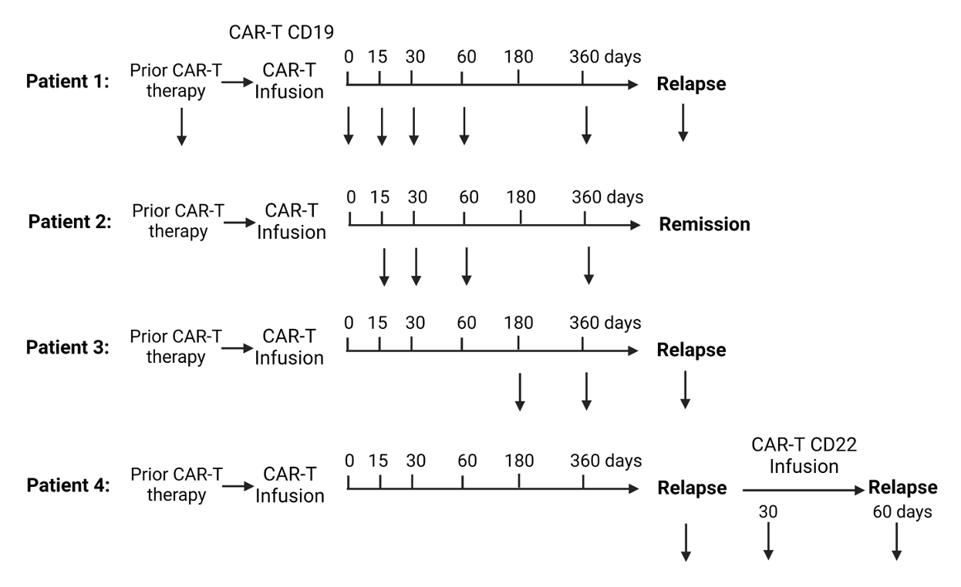
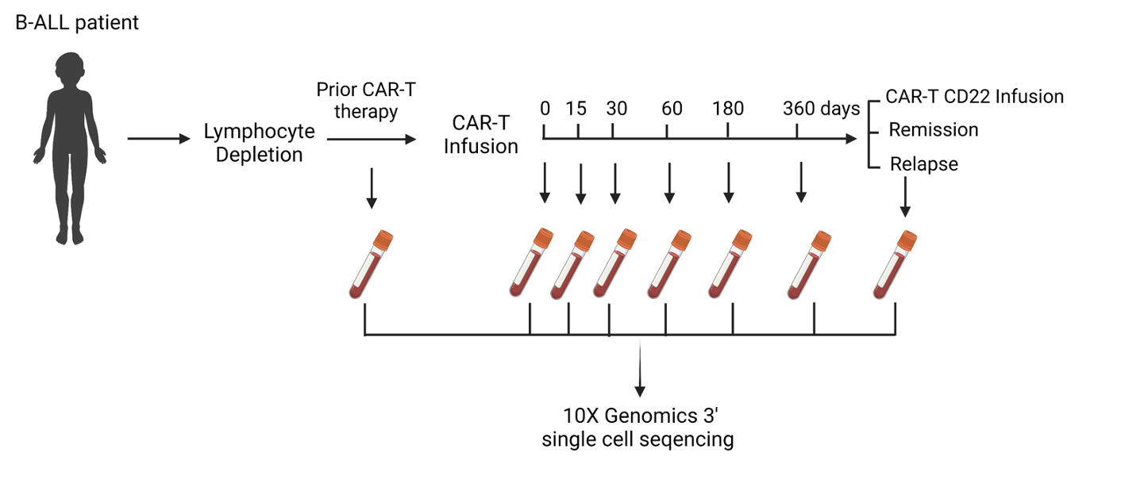
Question: Why CART-therapy works on some patient, but not others
Method: compare relapsed vs. remission patient’s
PBMC cell counts by different cell types, and
differential expression of genes in the same cell type
Na’s Figures
Notes:
PBMC: Peripheral blood mononuclear cells
I repeated Na’s experiment, made a few minor improvments

Slide 6
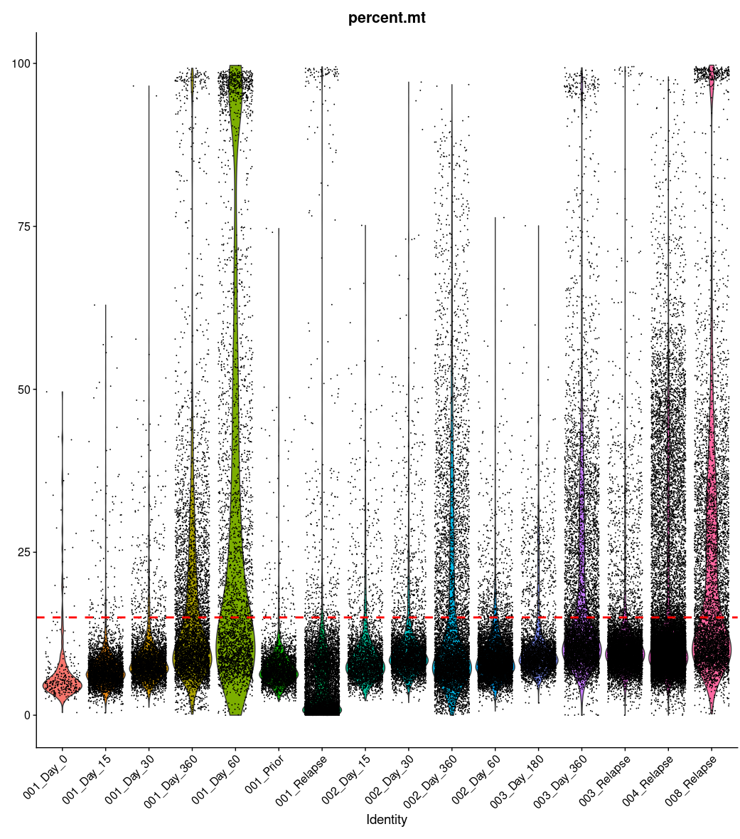
Pre-filter:
remove %mitochondria > 15%

Slide 7
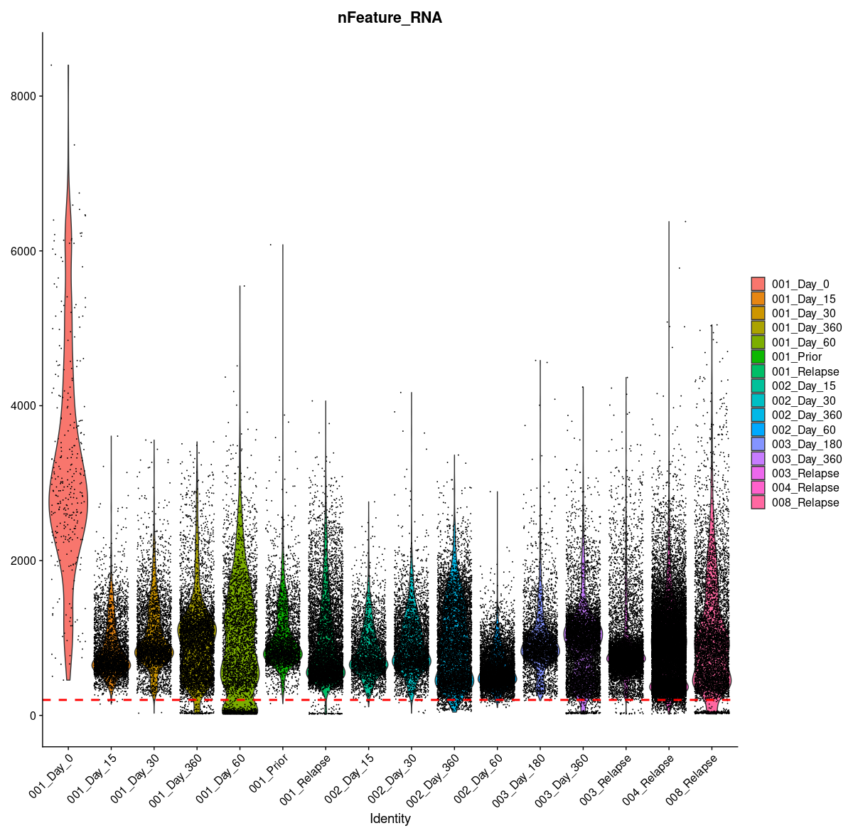
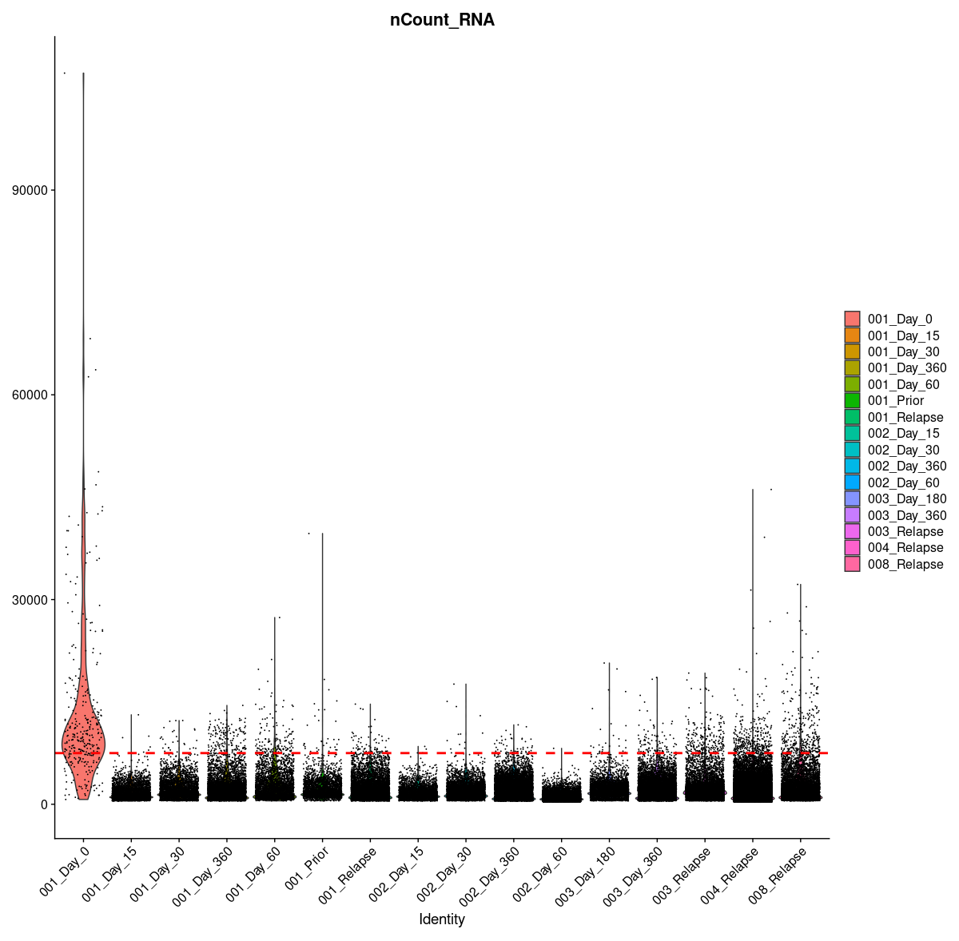
Remove #unique RNA < 200
Remove total RNA > 7500

Slide 8
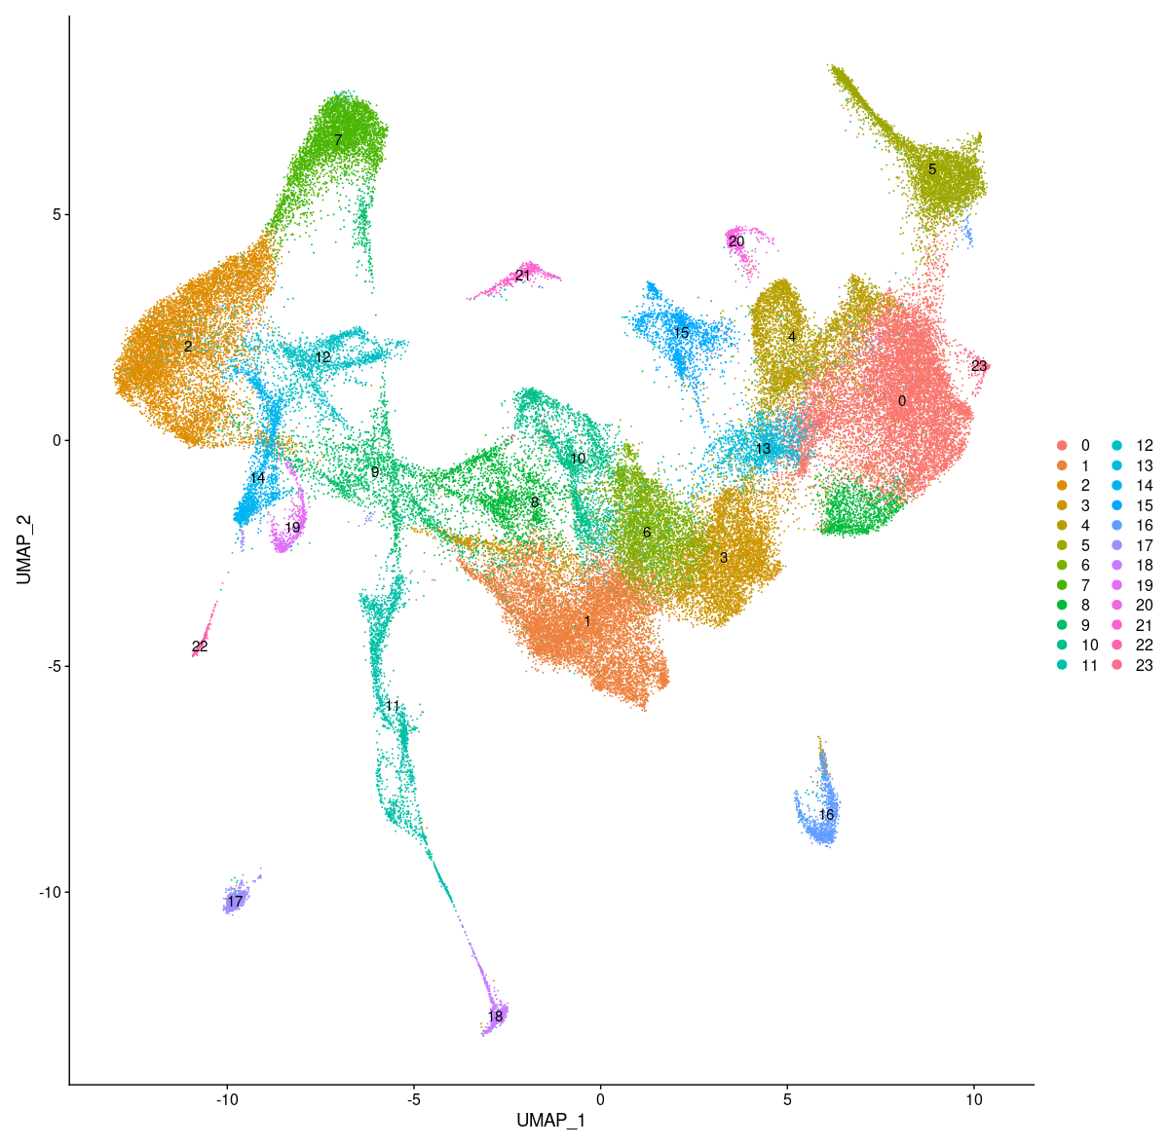
PBMC cell clustering of all patients, before labeling

Slide 9
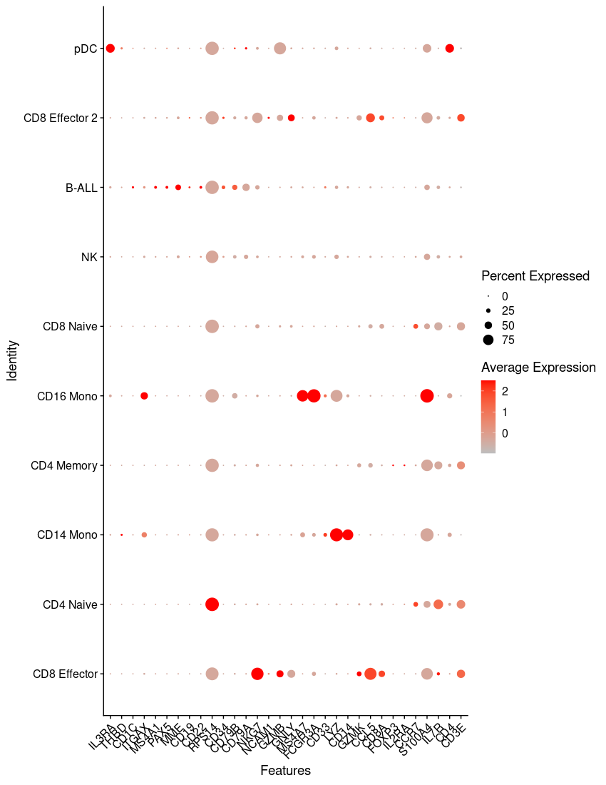
Method: Annotate each cluster by marker genes
Identified names | Alt. names | Markers
CD8 Effector | CD8+ Cytotoxic T cells | NKG7, GZMB, CD3E, CD8A,
NK | Natural Killer Cells | NKG7, GZMB, CD3E,
CD4 Naive | CD4 naïve /central memory (Tcm) | CCR7
CD4 Memory | CD4 Effector (Tem) Memory | IL7R, GZMK, CCR7-
CD8 Naive | CD8 naïve /central memory (Tcm) | CCR7, CD8A
CD14 Mono | CD16 - Monocyte | LYZ, CD14
CD16 Mono | CD16 + Monocyte | LYZ, MS4A7, FCGR3A/CD16
pDC | Plasmacytoid dendritic cells | IL3RA
B-ALL | Acute lymphoblastic leukemia B-cells | CD19, CD22, CD79A, CD79B
B-ALL CD19- | Acute lymphoblastic leukemia B-cells | CD19-, CD22, CD79A, CD79B,

Slide 10
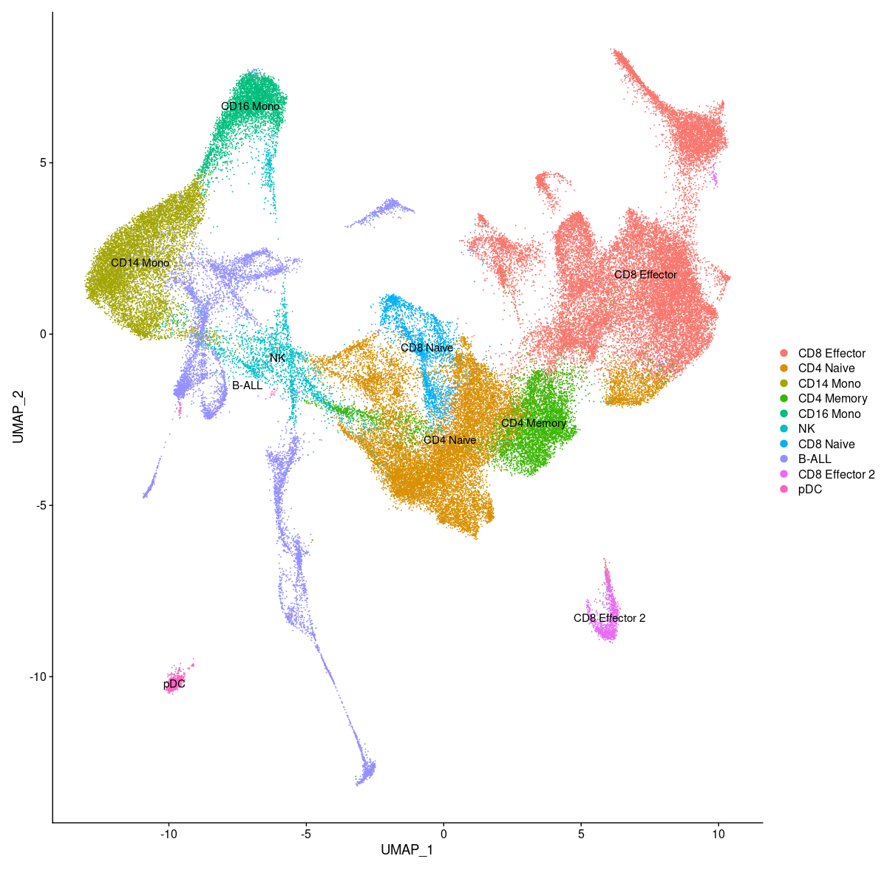
PBMC cell clustering of all patients, after labeling
Results: all major PBMC cell types are identified, similar cell types are neighbors
Notes:
Point out similar cell groups are together
Problem: unknown too big, look into; CD8 2 separate clusters

Slide 11
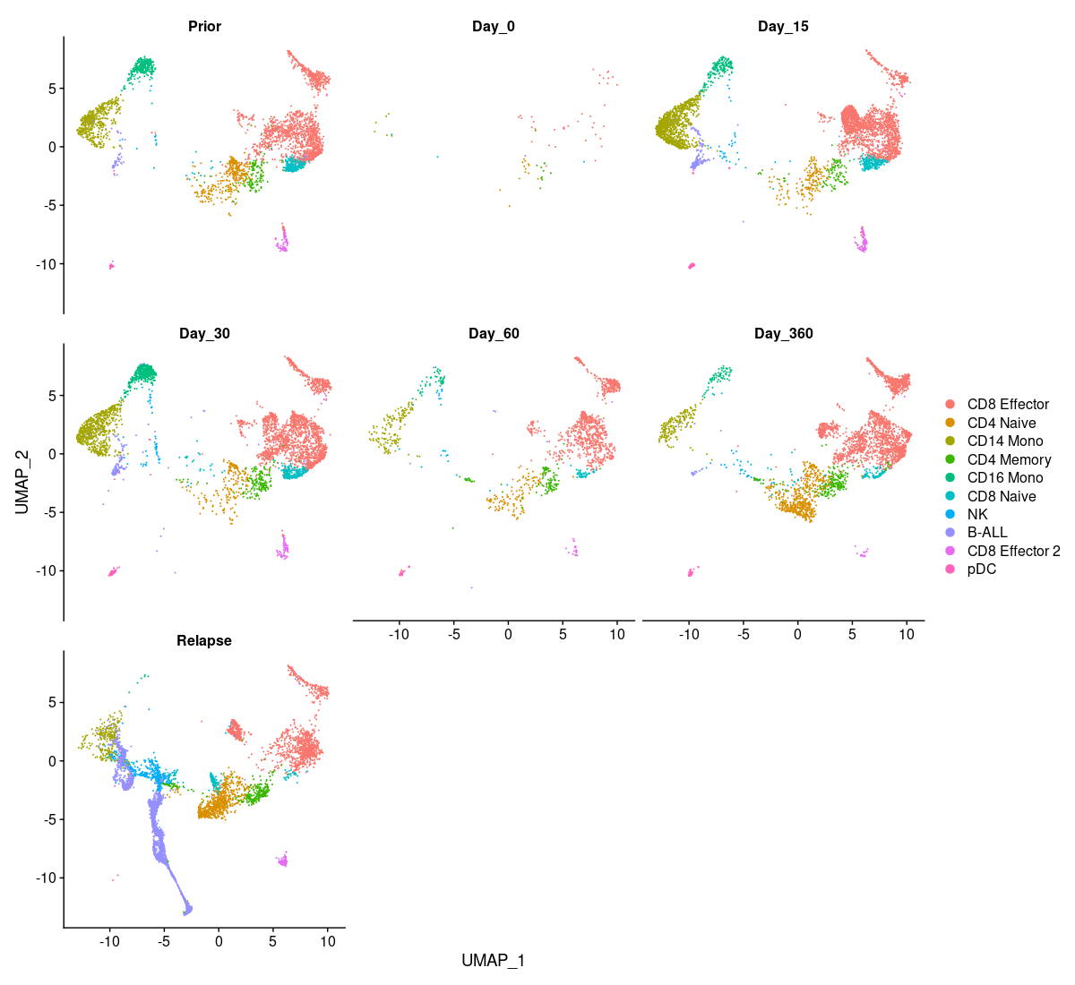
Patient 1: Relapsed
Method: separate each patient’s cells by the day of collection
Result: Relapsed patient shows their monocytes are diminishing

Slide 12
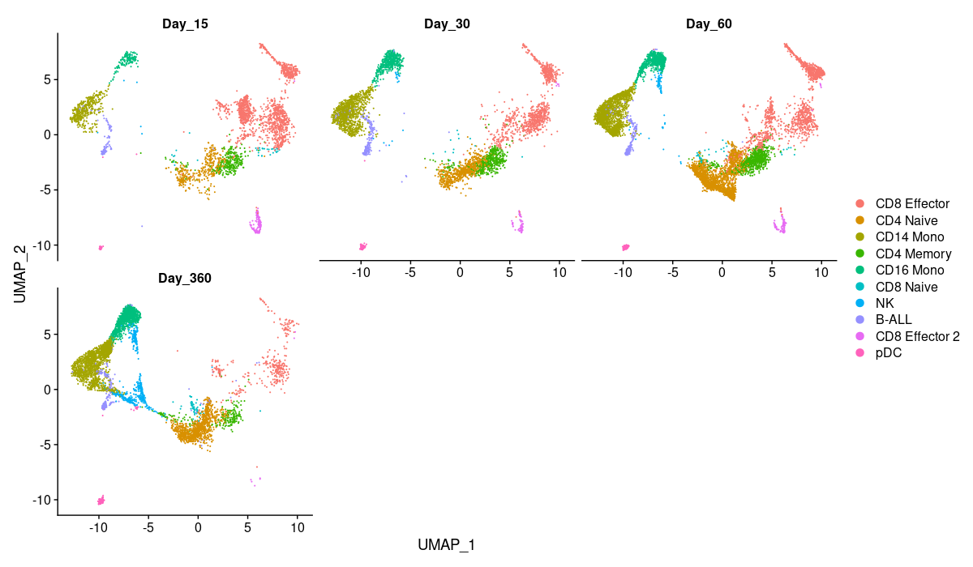
Patient 2: Remission
Method: separate each patient’s cells by the day of collection
Result: However, Remission patient shows their monocytes are increasing

Slide 13
Method: Plot the relative percentage of each cell type
Question: are there differentially expressed genes in monocytes
Notes:
Absolute number of cell does not matter; we normalize based on total cell count and get a percentage
2 observations
CD8 Effector
Monocytes

Slide 14
PBMC cell clustering of all patients, after labeling
Isolate cell type
Psuedo-bulk RNA analysis
Use the same cell type, different treatment/timepoint: find the DE genes (markers)
Visualize DE genes
Heat-map: expression level respective to own genes
Volcano-plot: expression level compared across group
Notes:
(markers genes that distinguish across the two samples)

Slide 15
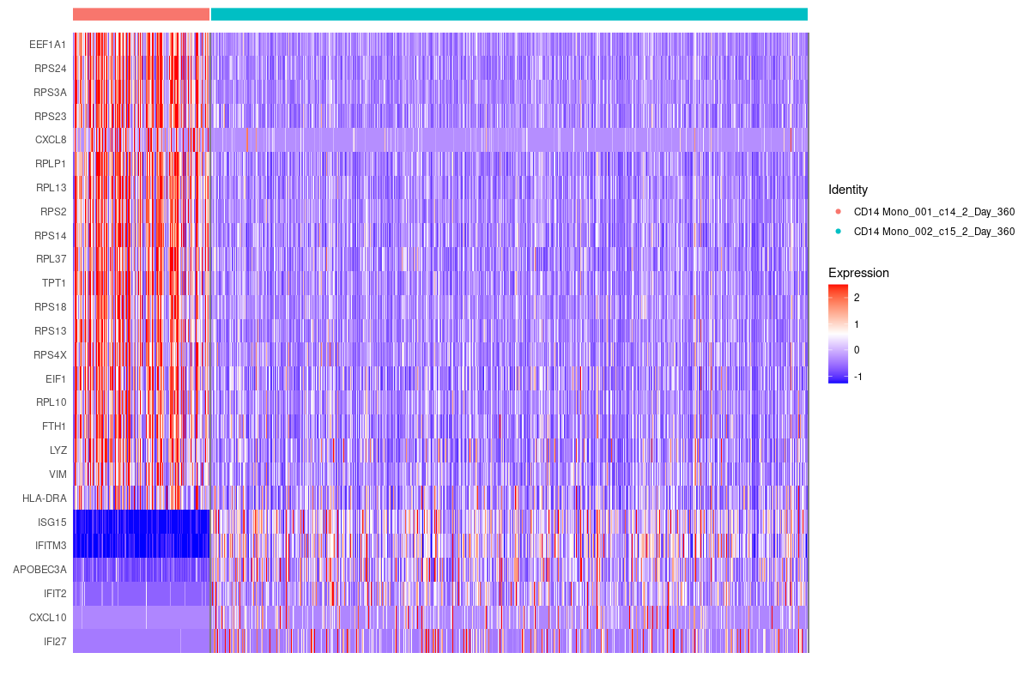
Method: Heat map showing the expression level of differentially expressed genes
CD14 Monocytes at Day-360 Patient 1 vs. 2
Relapsed
Remission
Other Potential Targets (not fully listed)
Interferon Stimulating Genes (ISG)

Slide 16
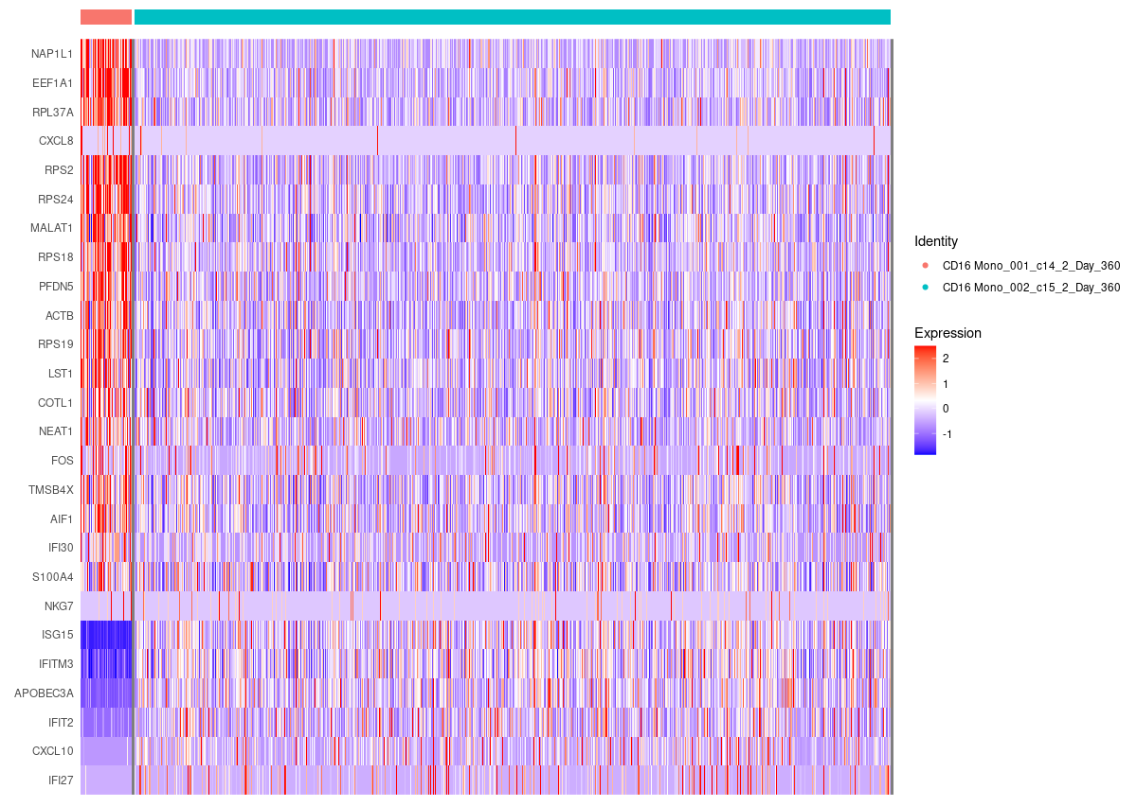
CD16 Monocytes at Day-360 Patient 1 vs. 2
Relapsed
Remission
Other Potential Targets (not fully listed)
Interferon Stimulating Genes (ISG)

Slide 17
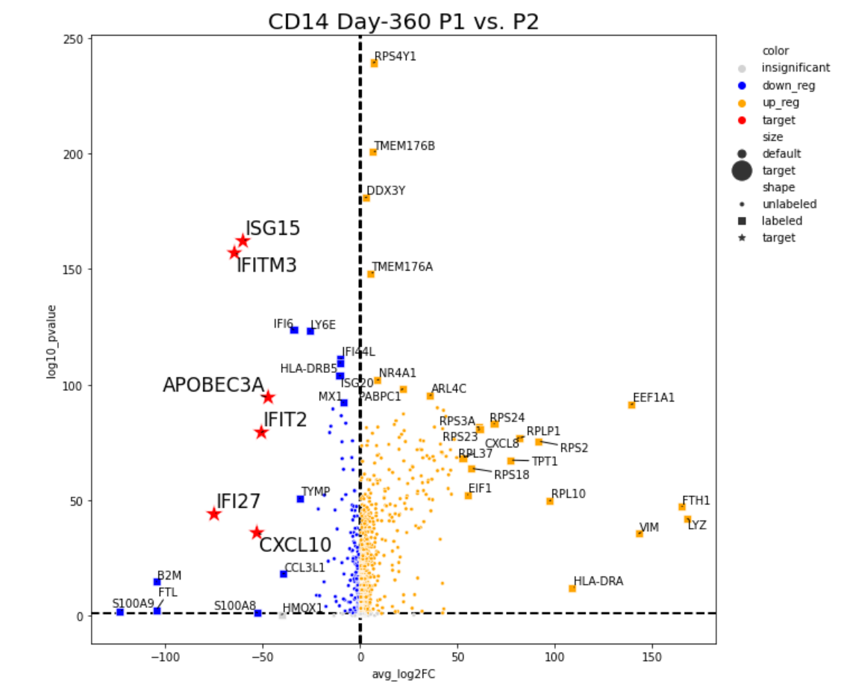
Method: Volcano plot showing other potential DE genes

Slide 18
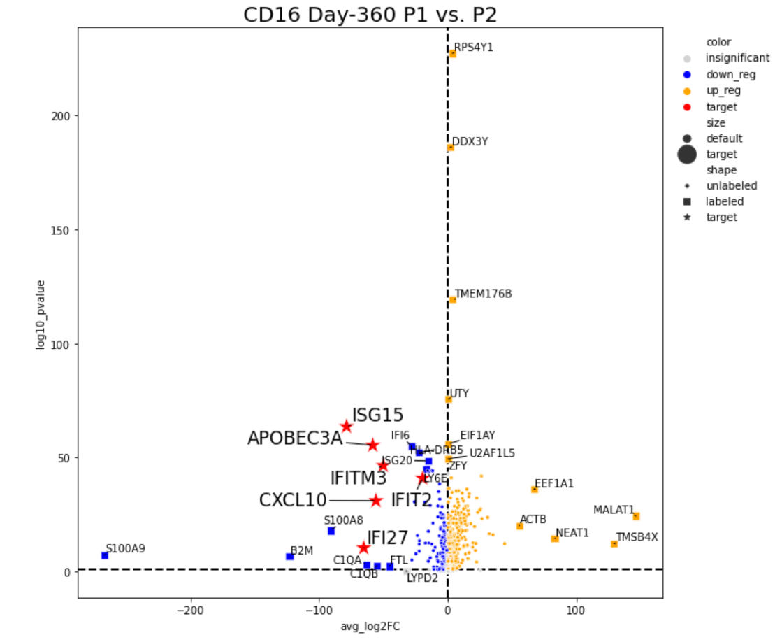

Slide 19
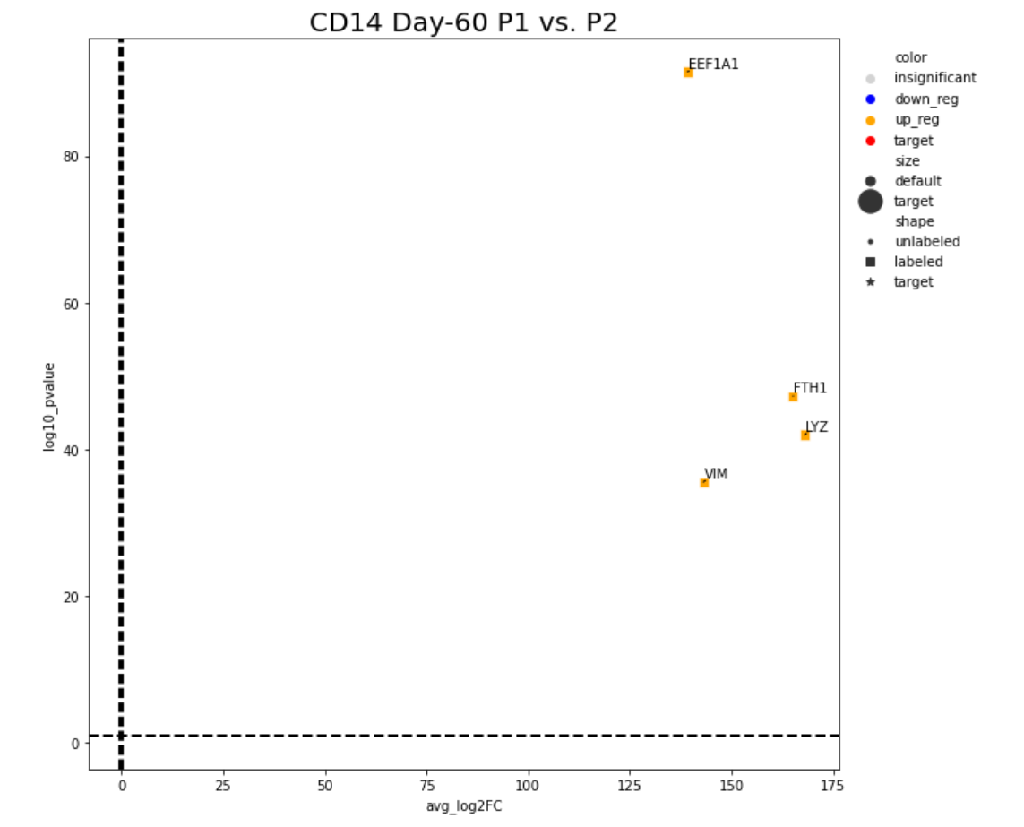
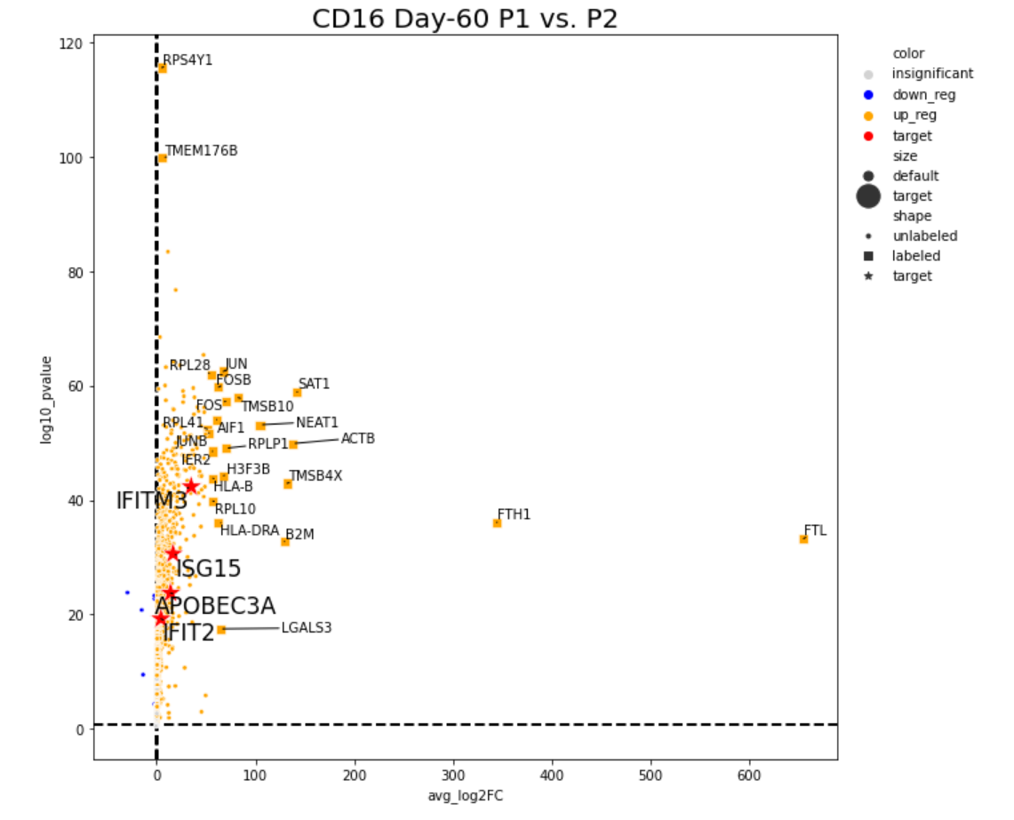
Result: Although at Day-360 ISGs have significant DE, at Day-60, none is observed
Notes:
LYZ FTH1

Slide 20
Conclusion
1) We identified all major cell types in PBMC samples
2) Found change in monocyte cell counts is related to remission/relapsed patients
3) ISGs are Differentially Expressed in Monocytes between remission/relapsed patients
4) ISG difference is observed in PBMC at Day-360, but not at Day-60
Discussion:
Consider increasing the single-cell sample number, or verify via other techniques directly
Functional validation of ISGs and upstream gene in mouse
Notes:
The problem with looking into large scale data set: if you look hard enough, across the 20k genes, somebody is going to be significantly different (by chance)
Higher sample count drastically reduce random false-positives

Slide 21
Next Step
Monocytes are hard to study in cell culture as they readily differentiate into macrophage and dendritic cells
Can we find DE genes from some t-cell cell type, as they are signal receiver of the monocytes

Slide 22
Acknowledgement
Thanks to Na’s support
Thanks to Zhouting and Lingling for answering my questions

Slide 23
References
Hucks, G. & Rheingold, S. R. The journey to CAR T cell therapy: the pediatric and young adult experience with relapsed or refractory B-ALL. Blood Cancer J 9, 10 (2019).
Hunger, S.P., Loh, M.L., Whitlock, J.A., Winick, N.J., Carroll, W.L., Devidas, M., Raetz, E.A. and (2013), Children's Oncology Group's 2013 blueprint for research: acute lymphoblastic leukemia. Pediatr. Blood Cancer, 60: 957-963. https://doi.org/10.1002/pbc.24420
Wang, K., Wei, G. & Liu, D. CD19: a biomarker for B cell development, lymphoma diagnosis and therapy. Exp Hematology Oncol 1, 36 (2012).
Brentjens, R. J. et al. Safety and persistence of adoptively transferred autologous CD19-targeted T cells in patients with relapsed or chemotherapy refractory B-cell leukemias. Blood 118, 4817–4828 (2011).
Leukemia: Symptoms, signs, causes, types &amp; treatment. Cleveland Clinic. (n.d.). Retrieved November 14, 2022, from https://my.clevelandclinic.org/health/diseases/4365-leukemia
The Children's Hospital of Philadelphia. (2014, January 28). Acute lymphoblastic leukemia (ALL). Children's Hospital of Philadelphia. Retrieved November 14, 2022, from https://www.chop.edu/conditions-diseases/acute-lymphoblastic-leukemia-all#:~:text=Acute%20lymphoblastic%20leukemia%20(ALL)%2C,year%20in%20the%20United%20States.

